Slide 1
Spatial Transformer
Ref: Max Jaderberg, Karen Simonyan, Andrew Zisserman, Koray Kavukcuoglu, “Spatial Transformer Networks”, NIPS, 2015
Notes:
Lastly, SPN can also retropropagate gradients to the image or previous layer it operates on, so they can be placed anywhere inside a neural net.

Slide 2

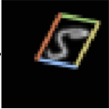
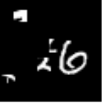
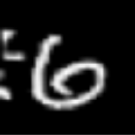
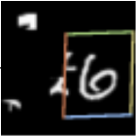
Spatial Transformer Layer
CNN is not invariant to scaling and rotation
CNN
5
CNN
6
NN layer
Can also transform feature map
End-to-end learn
Notes:
Training and test randomly rotated by (+/- 90°)

Slide 3
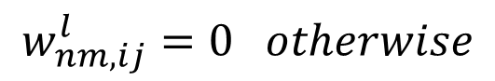
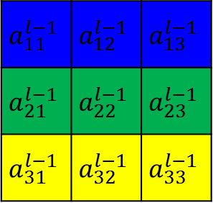
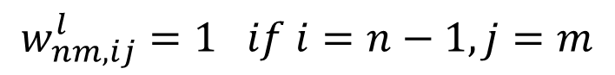
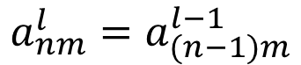
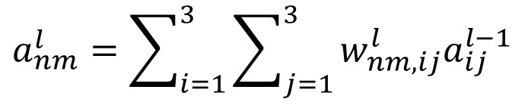
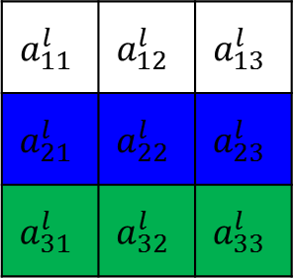
Spatial Transformer Layer
How to transform an image/feature map
Layer l-1
Layer l
$$a_{11}^{l−1}$$ | $$a_{12}^{l−1}$$ | $$a_{13}^{l−1}$$
$$a_{21}^{l−1}$$ | $$a_{22}^{l−1}$$ | $$a_{23}^{l−1}$$
$$a_{31}^{l−1}$$ | $$a_{32}^{l−1}$$ | $$a_{33}^{l−1}$$
Spatial Transformer Layer
$$a_{11}^{l}$$ | $$a_{12}^{l}$$ | $$a_{13}^{l}$$
$$a_{21}^{l}$$ | $$a_{22}^{l}$$ | $$a_{23}^{l}$$
$$a_{31}^{l}$$ | $$a_{32}^{l}$$ | $$a_{33}^{l}$$
Translate
$$a_{nm}^{l}=\sum_{i=1}^{3}{\sum_{j=1}^{3}{{w_{nm,ij}^{l}a}_{ij}^{l−1}}}$$
General layer:
If we want translate as above:
$$a_{nm}^{l}=a_{(n−1)m}^{l−1}$$
$$w_{nm,ij}^{l}=1 if i=n−1,j=m$$
$$w_{nm,ij}^{l}=0 otherwise$$
Notes:
Convoluation aly alter
In the illustration below, you can clearly see that the rotation places some points at locations that are not centered in the squares. This means that they would not have a corresponding pixel value in the original image.

Slide 4
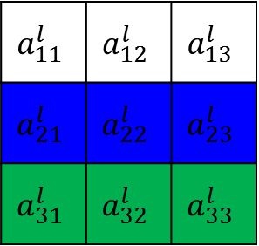
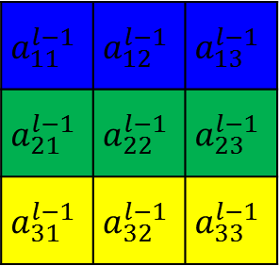
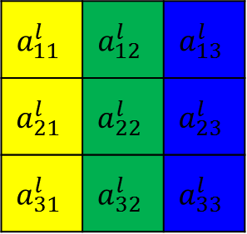
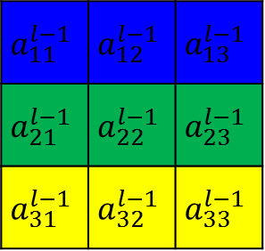
Spatial Transformer Layer
How to transform an image/feature map
Layer l-1
Layer l
Layer l-1
Layer l
$$a_{11}^{l−1}$$ | $$a_{12}^{l−1}$$ | $$a_{13}^{l−1}$$
$$a_{21}^{l−1}$$ | $$a_{22}^{l−1}$$ | $$a_{23}^{l−1}$$
$$a_{31}^{l−1}$$ | $$a_{32}^{l−1}$$ | $$a_{33}^{l−1}$$
$$a_{11}^{l}$$ | $$a_{12}^{l}$$ | $$a_{13}^{l}$$
$$a_{21}^{l}$$ | $$a_{22}^{l}$$ | $$a_{23}^{l}$$
$$a_{31}^{l}$$ | $$a_{32}^{l}$$ | $$a_{33}^{l}$$
$$a_{11}^{l−1}$$ | $$a_{12}^{l−1}$$ | $$a_{13}^{l−1}$$
$$a_{21}^{l−1}$$ | $$a_{22}^{l−1}$$ | $$a_{23}^{l−1}$$
$$a_{31}^{l−1}$$ | $$a_{32}^{l−1}$$ | $$a_{33}^{l−1}$$
$$a_{11}^{l}$$ | $$a_{12}^{l}$$ | $$a_{13}^{l}$$
$$a_{21}^{l}$$ | $$a_{22}^{l}$$ | $$a_{23}^{l}$$
$$a_{31}^{l}$$ | $$a_{32}^{l}$$ | $$a_{33}^{l}$$
Control the connection
Control the connection
NN
NN

Slide 5



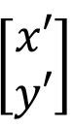
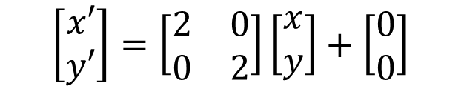
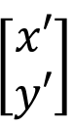
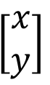
Image Transformation
Expansion, Compression, Translation
$$\left[\begin{aligned}x′ \\ y′\end{aligned}\right]$$
$$\left[\begin{aligned}x′ \\ y′\end{aligned}\right]=\left[\begin{matrix}2 & 0 \\ 0 & 2\end{matrix}\right]\left[\begin{aligned}x \\ y\end{aligned}\right]+\left[\begin{aligned}0 \\ 0\end{aligned}\right]$$
$$\left[\begin{aligned}x \\ y\end{aligned}\right]$$
1
$$\left[\begin{aligned}x′ \\ y′\end{aligned}\right]$$
1
$$\left[\begin{aligned}x′ \\ y′\end{aligned}\right]=\left[\begin{matrix}0.5 & 0 \\ 0 & 0.5\end{matrix}\right]\left[\begin{aligned}x \\ y\end{aligned}\right]+\left[\begin{aligned}0.5 \\ 0.5\end{aligned}\right]$$

Slide 6

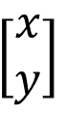

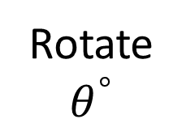
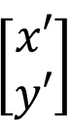
Image Transformation
https://home.gamer.com.tw/creationDetail.php?sn=792585
Rotation
$$\left[\begin{aligned}x′ \\ y′\end{aligned}\right]=\left[\begin{matrix}cosθ & −sinθ \\ sinθ & cosθ\end{matrix}\right]\left[\begin{aligned}x \\ y\end{aligned}\right]+\left[\begin{aligned}0 \\ 0\end{aligned}\right]$$
$$\left[\begin{aligned}x \\ y\end{aligned}\right]$$
$$\left[\begin{aligned}x′ \\ y′\end{aligned}\right]$$
Rotate
$$θ^{°}$$

Slide 7
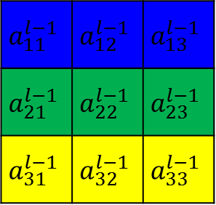
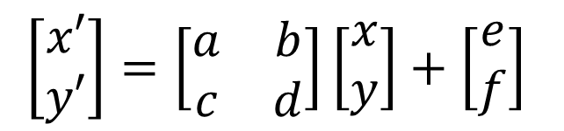
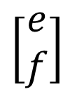
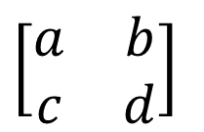
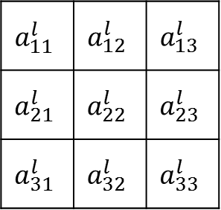
Spatial Transformer Layer
$$\left[\begin{aligned}x′ \\ y′\end{aligned}\right]=\left[\begin{matrix}a & b \\ c & d\end{matrix}\right]\left[\begin{aligned}x \\ y\end{aligned}\right]+\left[\begin{aligned}e \\ f\end{aligned}\right]$$
6 parameters to describe the affine transformation
Index of layer l-1
Index of layer l
$$a_{11}^{l−1}$$ | $$a_{12}^{l−1}$$ | $$a_{13}^{l−1}$$
$$a_{21}^{l−1}$$ | $$a_{22}^{l−1}$$ | $$a_{23}^{l−1}$$
$$a_{31}^{l−1}$$ | $$a_{32}^{l−1}$$ | $$a_{33}^{l−1}$$
$$a_{11}^{l}$$ | $$a_{12}^{l}$$ | $$a_{13}^{l}$$
$$a_{21}^{l}$$ | $$a_{22}^{l}$$ | $$a_{23}^{l}$$
$$a_{31}^{l}$$ | $$a_{32}^{l}$$ | $$a_{33}^{l}$$
Layer l-1
Layer l
$$\left[\begin{matrix}a & b \\ c & d\end{matrix}\right]$$
$$\left[\begin{aligned}e \\ f\end{aligned}\right]$$
NN

Slide 8
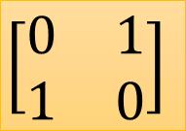
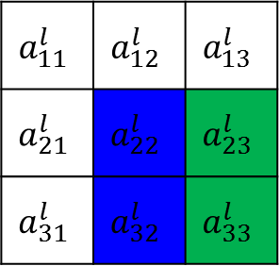
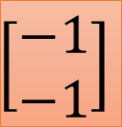

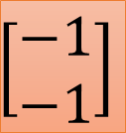
Spatial Transformer Layer
$$\left[\begin{aligned}x′ \\ y′\end{aligned}\right]=\left[\begin{matrix}a & b \\ c & d\end{matrix}\right]\left[\begin{aligned}x \\ y\end{aligned}\right]+\left[\begin{aligned}e \\ f\end{aligned}\right]$$
6 parameters to describe the affine transformation
$$\left[\begin{matrix}0 & 1 \\ 1 & 0\end{matrix}\right]$$
$$\left[\begin{matrix}−1 \\ −1\end{matrix}\right]$$
Index of layer l-1
Index of layer l
$$a_{11}^{l}$$ | $$a_{12}^{l}$$ | $$a_{13}^{l}$$
$$a_{21}^{l}$$ | $$a_{22}^{l}$$ | $$a_{23}^{l}$$
$$a_{31}^{l}$$ | $$a_{32}^{l}$$ | $$a_{33}^{l}$$
$$a_{11}^{l−1}$$ | $$a_{12}^{l−1}$$ | $$a_{13}^{l−1}$$
$$a_{21}^{l−1}$$ | $$a_{22}^{l−1}$$ | $$a_{23}^{l−1}$$
$$a_{31}^{l−1}$$ | $$a_{32}^{l−1}$$ | $$a_{33}^{l−1}$$
$$a_{11}^{l}$$ | $$a_{12}^{l}$$ | $$a_{13}^{l}$$
$$a_{21}^{l}$$ | $$a_{22}^{l}$$ | $$a_{23}^{l}$$
$$a_{31}^{l}$$ | $$a_{32}^{l}$$ | $$a_{33}^{l}$$
Layer l-1
Layer l
$$\left[\begin{matrix}0 & 1 \\ 1 & 0\end{matrix}\right]$$
$$\left[\begin{matrix}−1 \\ −1\end{matrix}\right]$$
$$\left[\begin{matrix}a & b \\ c & d\end{matrix}\right]$$
$$\left[\begin{aligned}e \\ f\end{aligned}\right]$$
NN

Slide 9
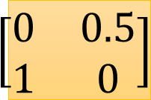
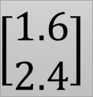

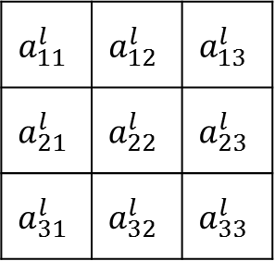
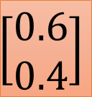
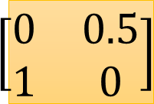

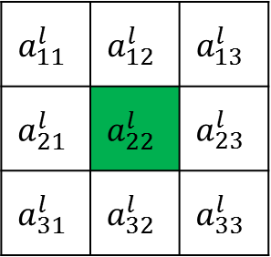
Spatial Transformer Layer
$$\left[\begin{aligned}x′ \\ y′\end{aligned}\right]=\left[\begin{matrix}a & b \\ c & d\end{matrix}\right]\left[\begin{aligned}x \\ y\end{aligned}\right]+\left[\begin{aligned}e \\ f\end{aligned}\right]$$
6 parameters to describe the affine transformation
$$\left[\begin{matrix}1.6 \\ 2.4\end{matrix}\right]$$
$$\left[\begin{matrix}0 & 0.5 \\ 1 & 0\end{matrix}\right]$$
$$\left[\begin{matrix}2 \\ 2\end{matrix}\right]$$
$$\left[\begin{matrix}0.6 \\ 0.4\end{matrix}\right]$$
Index of layer l-1
Index of layer l
What is the problem?
$$a_{11}^{l}$$ | $$a_{12}^{l}$$ | $$a_{13}^{l}$$
$$a_{21}^{l}$$ | $$a_{22}^{l}$$ | $$a_{23}^{l}$$
$$a_{31}^{l}$$ | $$a_{32}^{l}$$ | $$a_{33}^{l}$$
$$a_{11}^{l}$$ | $$a_{12}^{l}$$ | $$a_{13}^{l}$$
$$a_{21}^{l}$$ | $$a_{22}^{l}$$ | $$a_{23}^{l}$$
$$a_{31}^{l}$$ | $$a_{32}^{l}$$ | $$a_{33}^{l}$$
$$a_{11}^{l−1}$$ | $$a_{12}^{l−1}$$ | $$a_{13}^{l−1}$$
$$a_{21}^{l−1}$$ | $$a_{22}^{l−1}$$ | $$a_{23}^{l−1}$$
$$a_{31}^{l−1}$$ | $$a_{32}^{l−1}$$ | $$a_{33}^{l−1}$$
$$a_{11}^{l}$$ | $$a_{12}^{l}$$ | $$a_{13}^{l}$$
$$a_{21}^{l}$$ | $$a_{22}^{l}$$ | $$a_{23}^{l}$$
$$a_{31}^{l}$$ | $$a_{32}^{l}$$ | $$a_{33}^{l}$$
Layer l-1
Layer l
$$\left[\begin{matrix}0 & 0.5 \\ 1 & 0\end{matrix}\right]$$
$$\left[\begin{matrix}0.6 \\ 0.4\end{matrix}\right]$$
$$\left[\begin{matrix}a & b \\ c & d\end{matrix}\right]$$
$$\left[\begin{aligned}e \\ f\end{aligned}\right]$$
NN
Gradient is always zero

Slide 10
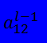
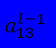
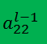
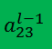
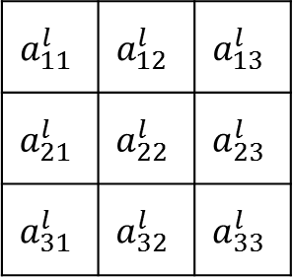
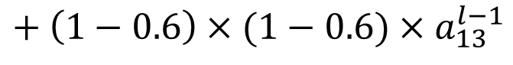
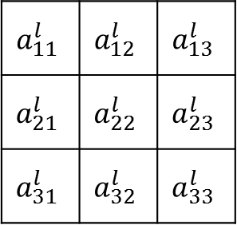
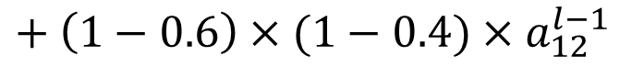
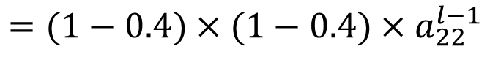
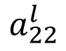

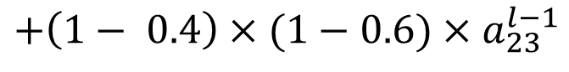
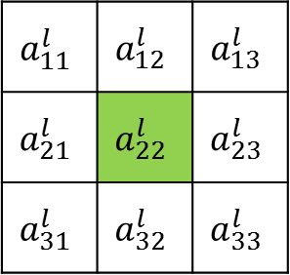
Interpolation
Now we can use gradient descent
$$\left[\begin{aligned}x′ \\ y′\end{aligned}\right]=\left[\begin{matrix}a & b \\ c & d\end{matrix}\right]\left[\begin{aligned}x \\ y\end{aligned}\right]+\left[\begin{aligned}e \\ f\end{aligned}\right]$$
6 parameters to describe the affine transformation
$$\left[\begin{matrix}1.6 \\ 2.4\end{matrix}\right]$$
$$\left[\begin{matrix}0 & 0.5 \\ 1 & 0\end{matrix}\right]$$
$$\left[\begin{matrix}2 \\ 2\end{matrix}\right]$$
$$\left[\begin{matrix}0.6 \\ 0.4\end{matrix}\right]$$
Index of layer l-1
Index of layer l
$$a_{11}^{l}$$ | $$a_{12}^{l}$$ | $$a_{13}^{l}$$
$$a_{21}^{l}$$ | $$a_{22}^{l}$$ | $$a_{23}^{l}$$
$$a_{31}^{l}$$ | $$a_{32}^{l}$$ | $$a_{33}^{l}$$
$$a_{11}^{l}$$ | $$a_{12}^{l}$$ | $$a_{13}^{l}$$
$$a_{21}^{l}$$ | $$a_{22}^{l}$$ | $$a_{23}^{l}$$
$$a_{31}^{l}$$ | $$a_{32}^{l}$$ | $$a_{33}^{l}$$
$$a_{11}^{l}$$ | $$a_{12}^{l}$$ | $$a_{13}^{l}$$
$$a_{21}^{l}$$ | $$a_{22}^{l}$$ | $$a_{23}^{l}$$
$$a_{31}^{l}$$ | $$a_{32}^{l}$$ | $$a_{33}^{l}$$
0.4
0.6
Layer l
0.6
0.6
$$\left[\begin{matrix}1.6 \\ 2.4\end{matrix}\right]$$
$$a_{22}^{l}$$
$$=(1−0.4)×(1−0.4)×a_{22}^{l−1}$$
0.4
0.4
$$+ \left(1−0.6\right)×(1−0.4)×a_{12}^{l−1}$$
$$+ \left(1−0.6\right)×(1−0.6)×a_{13}^{l−1}$$
0.4
0.6
$$+\left(1− 0.4\right)×(1−0.6)×a_{23}^{l−1}$$

Slide 11
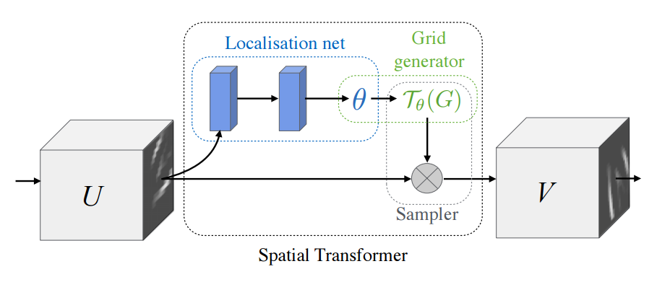
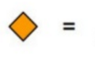


Slide 12


Slide 13

Street View
House Number
Single: one transformation layer
Multi: many transformation layer
Notes:
Sequence error
DRAM: https://arxiv.org/pdf/1412.7755.pdf

Slide 14



Brid Recognition
$$\left[\begin{matrix}a & b \\ c & d\end{matrix}\right]$$
0
$$\left[\begin{aligned}e \\ f\end{aligned}\right]$$
0
Notes:
one spatial transformer (red) has learnt
to become a head detector, while the other (green) fixates on the central part of the body of a bird.

Slide 15

Highway Network & Grid LSTM

Slide 16
Feedforward v.s. Recurrent
1. Feedforward network does not have input at each step
2. Feedforward network has different parameters for each layer
x
f₁
a¹
f₂
a²
f₃
a³
f₄
y
$$a^{t}=f_{l}\left(a^{t−1}\right)=σ\left(W^{t}a^{t−1}+b^{t}\right)$$
t is layer
h⁰
f
h¹
f
h²
f
h³
f
g
y⁴
x¹
x²
x³
x⁴
t is time step
$$a^{t}=f\left(a^{t−1},x^{t}\right)=σ\left(W^{h}a^{t−1}+W^{i}x^{t}+b^{i}\right)$$
Applying gated structure in feedforward network

Slide 17





GRU $→$ Highway Network
y^{t}
No input x^{t} at each step
a^{t-1}
h^{t}
h^{t-1}
$$⨀$$
$$＋$$
a^{t}
No output y^{t} at each step
$$⨀$$
1-
$$⨀$$
a^{t-1} is the output of the (t-1)-th layer
reset
update
a^{t} is the output of the t-th layer
r
z
h'
No reset gate
a^{t-1}
h^{t-1}
x^{t}
x^{t}

Slide 18











Highway Network
$$h^{′}=σ\left(Wa^{t−1}\right)$$
$$z=σ\left(W′a^{t−1}\right)$$
$$a^{t}=z⊙a^{t−1}+\left(1−z\right)⊙h$$
Highway Network
Residual Network
$$a^{t}$$
$$a^{t}$$
+
$$z$$
$$a^{t−1}$$
$$h^{′}$$
Gate controller
$$h′$$
copy
copy
$$a^{t−1}$$
$$a^{t−1}$$
Training Very Deep Networks
https://arxiv.org/pdf/1507.06228v2.pdf
Deep Residual Learning for Image Recognition
http://arxiv.org/abs/1512.03385

Slide 19
output layer
output layer
output layer
Highway Network automatically
determines the layers needed!
Input layer
Input layer
Input layer
Notes:
There are many interesting thin in highway network

Slide 20
Highway Network

Slide 21
Grid LSTM
Memory for both time and depth
depth
y
a’
b’
LSTM
c’
Grid
LSTM
c’
c
c
h^{t}
h’
h
h
x
a
b
time

Slide 22
a^{l+1}
b^{l+1}
a^{l+1}
b^{l+1}
c^{t-1}
Grid
LSTM’
c^{t}
Grid
LSTM’
c^{t+1}
h^{t-1}
h^{t}
h^{t+1}
a^{l}
b^{l}
a^{l}
b^{l}
c^{t-1}
Grid
LSTM
c^{t}
Grid
LSTM
c^{t+1}
h^{t-1}
h^{t}
h^{t+1}
a^{l-1}
b^{l-1}
a^{l-1}
b^{l-1}

Slide 23




Grid LSTM
h'
b'
a’
b’
c
c'
a
$$⨀$$
$$＋$$
$$⨀$$
a'
Grid
LSTM
c’
tanh
c
$$⨀$$
h’
h
z^{f}
z^{i}
z
zº
a
b
h
b

Slide 24

3D Grid LSTM
a’
b’
e’
f’
c
c’
h
h’
e
f
a
b
Notes:
When do we need this one??????

Slide 25
Recursive Structure

Slide 26
Application: Sentiment Analysis
h⁰
f
h¹
f
h²
f
h³
f
g
sentiment
x¹
x²
x³
x⁴
word vector
Word Sequence
h³
g
Recurrent Structure
Special case of recursive structure
f
h¹
same dimension
h²
Recursive Structure
How to stack function f is already determined
f
f
x¹
x²
x³
x⁴

Slide 27
Recursive Model
syntactic structure
How to do it is out of the scope
not
very
good
word sequence:
not
very
good
Notes:
https://openreview.net/pdf?id=Skvgqgqxe
Cons$tuency
(phrase
structure)

Slide 28
Recursive Model
syntactic structure
By composing the two meaning, what should the meaning be.
not
very
good
Dimension of word vector = |Z|
Meaning of “very good”
V(“very good”)
Input: 2 X |Z|, output: |Z|
f
V(“not”)
V(“very”)
V(“good”)
not
very
good
Notes:
Cons$tuency
(phrase
structure)

Slide 29
Recursive Model
syntactic structure
V(w_{A} w_{B}) ≠ V(w_{A}) + V(w_{B})
“not”: neutral
not
very
good
“good”: positive
“not good”: negative
Meaning of “very good”
V(“very good”)
f
V(“not”)
V(“very”)
V(“good”)
not
very
good
Notes:
Cons$tuency
(phrase
structure)

Slide 30
Recursive Model
syntactic structure
V(w_{A} w_{B}) ≠ V(w_{A}) + V(w_{B})
“棒”: positive
not
very
good
“好棒”: positive
“好棒棒”: negative
Meaning of “very good”
V(“very good”)
network
f
V(“not”)
V(“very”)
V(“good”)
not
very
good
Notes:
Cons$tuency
(phrase
structure)

Slide 31
Recursive Model
syntactic structure
“not good”
“not bad”
not
very
good
f
f
Meaning of “very good”
“not”
“good”
“not”
“bad”
V(“very good”)
: “reverse” another input
f
“not”
V(“not”)
V(“very”)
V(“good”)
not
very
good
Notes:
Cons$tuency
(phrase
structure)

Slide 32
Recursive Model
syntactic structure
“very good”
“very bad”
not
very
good
f
f
Meaning of “very good”
“very”
“good”
“very”
“bad”
V(“very good”)
: “emphasize” another input
f
“very”
V(“not”)
V(“very”)
V(“good”)
not
very
good
Notes:
Cons$tuency
(phrase
structure)

Slide 33
-
ref
5 classes
( -- , - , 0 , + , ++ )
output
g
Train both …
V(“not very good”)
f
f
g
f
V(“not”)
V(“very”)
V(“good”)
not
very
good
Notes:
http://nlp.stanford.edu:8080/sentiment/rntnDemo.html
Cons$tuency
(phrase
structure)

Slide 34





Recursive Neural Tensor Network
$$p$$
W
$$=σ\left( \right)$$
f
Little interaction between a and b
$$a$$
$$b$$
$$\sum_{i,j}{W_{ij}x_{i}x_{j}}$$
W
x
x^{T}
+
$$=σ\left( \right)$$
Notes:
Advantages
Single layer can model complex interactions
Disadvantages
Tensor V is potentially gigantic
Room for research on tensor networks?
Does not appear to be well-explored
Cubic parameter growth
Highly expressive

Slide 35

Experiments
5-class sentiment classification ( -- , - , 0 , + , ++ )
Demo: http://nlp.stanford.edu:8080/sentiment/rntnDemo.html

Slide 36


Experiments
Socher, Richard, et al. "Recursive deep models for semantic compositionality over a sentiment treebank." Proceedings of the conference on empirical methods in natural language processing (EMNLP). Vol. 1631. 2013.
Notes:
Dull 平淡

Slide 37






Matrix-Vector Recursive Network
f
inherent meaning
how it changes the others
=
W
=
W_{M}
=
$$σ\left( \right)$$
=
$$a$$
Informative?
$$A$$
$$b$$
$$B$$
Zero?
$\left[\begin{matrix}−1 & 0 \\ 0 & −1\end{matrix}\right]$?
Identity?
not
good
Notes:
Richard Socher Brody Huval Christopher D. Manning Andrew Y. Ng EMNLP 2012

Slide 38

Tree LSTM
h^{t-1}
h^{t}
LSTM
Typical LSTM
m^{t-1}
m^{t}
Tree LSTM
x^{t}
h³
m³
LSTM
h¹
m¹
m²
h²

Slide 39


More Applications
Sentence relatedness
NN
Recursive Neural Network
Recursive Neural Network
Tai, Kai Sheng, Richard Socher, and Christopher D. Manning. "Improved semantic representations from tree-structured long short-term memory networks." arXiv preprint arXiv:1503.00075 (2015).
Sentence 1
Sentence 2

Slide 40
Batch Normalization

Slide 41
Experimental Results

